Slide 1

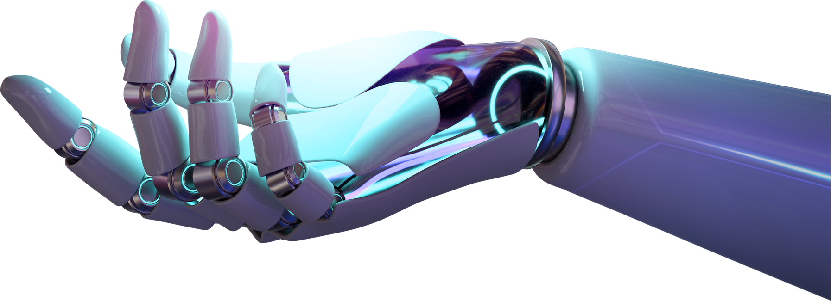

Python
UNLOCKING THE POWER OF ONE OF THE WORLD'S MOST POPULAR PROGRAMMING LANGUAGES

Slide 2




The speakers
github.com/charlimiqueloto
github.com/wagnersantiago
Wagner
Charliane

Slide 3
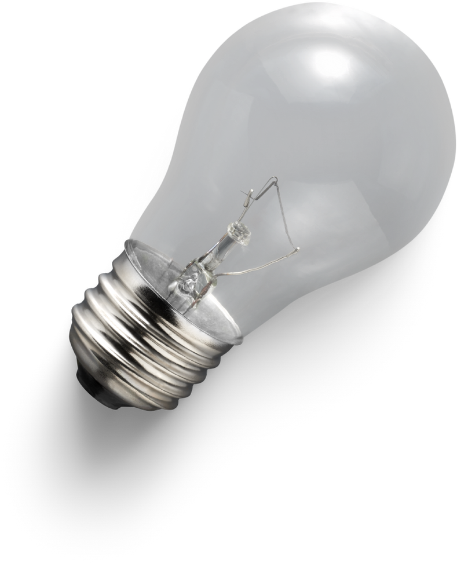
1.
3.
History
Python's Standard Library
Key milestones from its inception in 1991 to its current version.
Highlight its growth in popularity over the years.
Highlight some of the most useful modules (e.g., math, datetime, os, random).
2.
4.
Basics
Started with Python
Syntax: Show examples of Python's clean and simple syntax.
Variables and Data Types: Introduce basic data types (int, float, string, list, dictionary).
Tips on setting up the environment (installing Python, choosing an IDE).
Encourage experimenting with small projects and contributing to open-source projects.
Table of contents

Slide 4
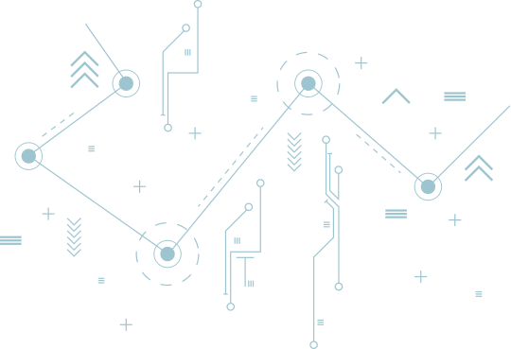




Python – a tool, not a reptile
Creation: Python, created by Guido van Rossum, was first released in 1991 as a language emphasizing code readability.
Philosophy: Influenced by ABC and Modula-3, its design follows "The Zen of Python" which promotes simplicity and elegance.
History of Python
Evolution: Python has evolved through major updates, with Python 3.0 in 2008 making significant improvements for consistency and efficiency.

Slide 5

In 1999, he defined his goals for Python:
easy and intuitive
understandable
suitable for everyday tasks
One of the amazing features of Python is the fact that it is actually one person's work.
Guido van Rossum

Slide 6
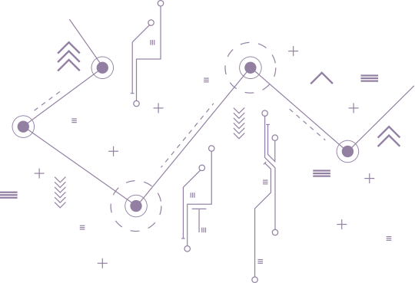
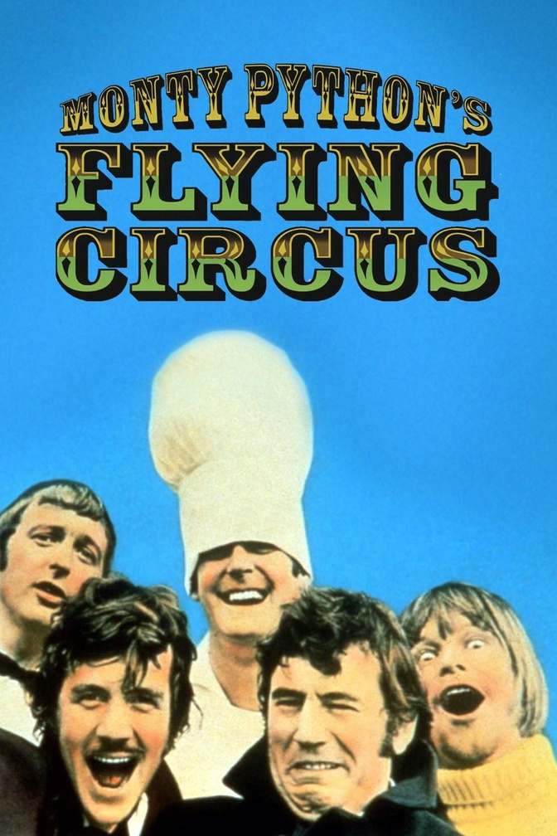
Curiosity
And while you may know the python as a large snake, the name of the Python programming language comes from an old BBC television comedy sketch series called Monty Python's Flying Circus.
At the height of its success, the Monty Python team were performing their sketches to live audiences across the world, including at the Hollywood Bowl.
Since Monty Python is considered one of the two fundamental nutrients to a programmer (the other being pizza), Python's creator named the language in honor of the TV show.

Slide 7

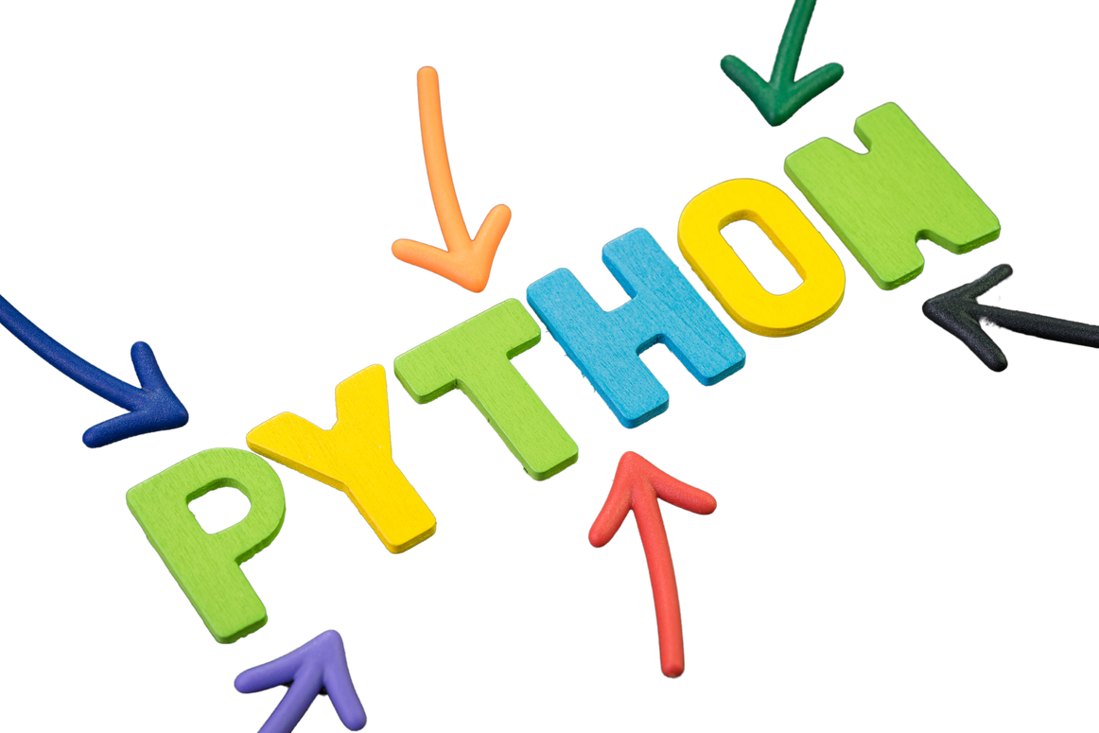


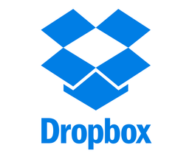
Built-in Python
Instagram uses Python on its backend. Python's simplicity and robustness allow Instagram to handle massive amounts of data and interactions.
Spotify uses Python primarily for data analysis and backend services. Python's speed and ease of use help Spotify manage its vast datasets and complex back-end operations efficiently.
Netflix uses Python for data analysis, operational automation, and security. Python's libraries and frameworks enable Netflix to process vast amounts of data, enhancing user experience through personalization.
Dropbox, a cloud storage service, started its journey with Python, and it continues to use it for its desktop client and server infrastructure. Python's simplicity and the ability to scale were crucial for Dropbox's growth.

Slide 8
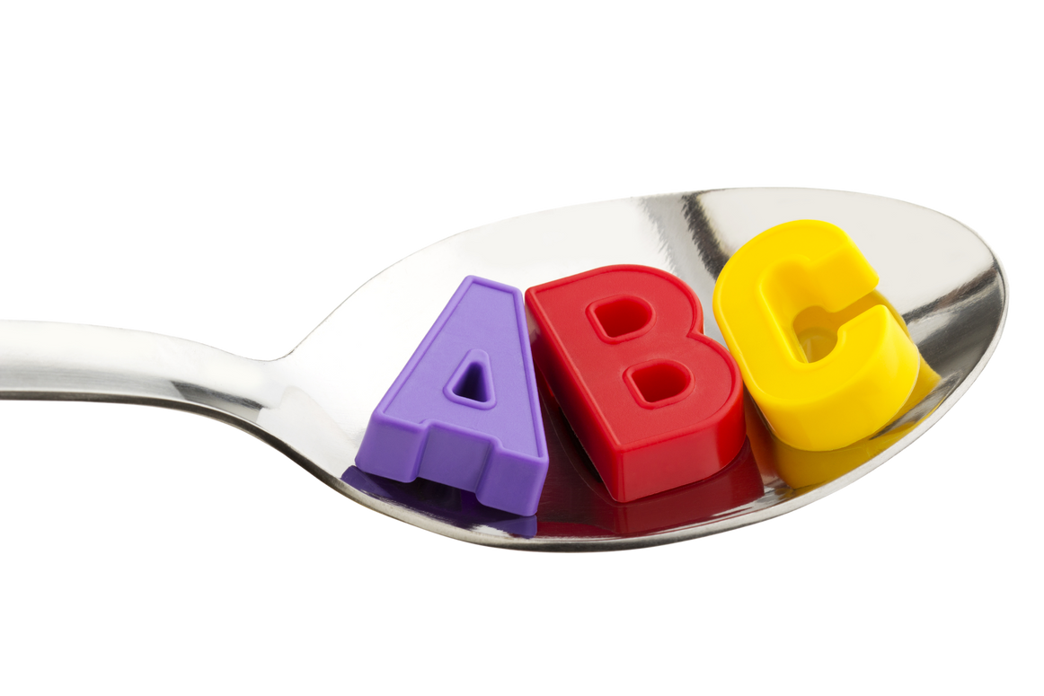



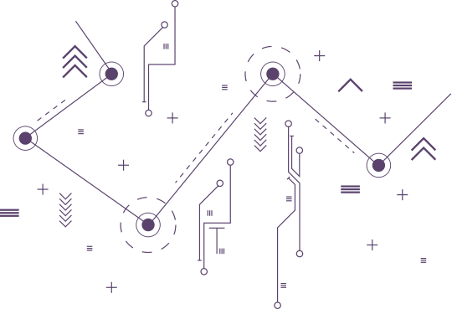
Basics of Python
Python's syntax is designed to be intuitive and readable, making it easy for beginners to understand and start programming.
Python supports a variety of data types, allowing for flexible and dynamic programming styles.

Slide 9

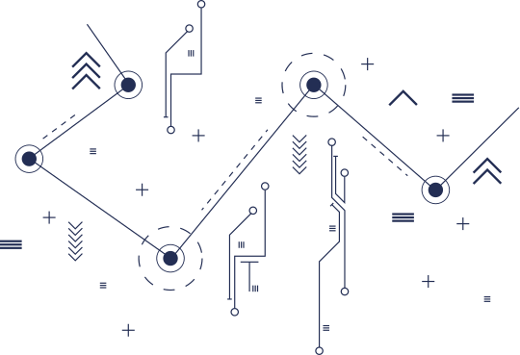
Basics of Python
Variables and Data Types
Python supports a variety of data types, allowing for flexible and dynamic programming styles.
int
x = 5
boolean
is_student = True
has_books = False
float
y = 3.14
dictionary
my_dict = {"key": "value"}
string
name = "Python"
list
my_list = [1, 2, 3]

Slide 10
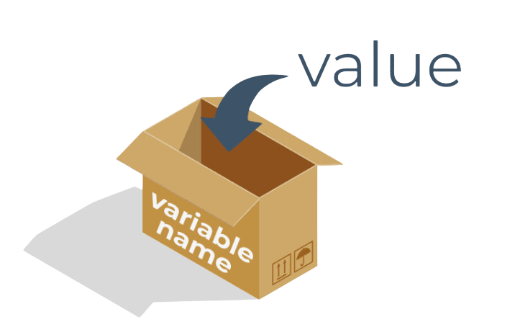
Variables
What does every Python variable have?
a name;
a value (the content of the container)
Variables are not typed in Python

Slide 11

Conditional Execution
Python uses conditional statements to execute different blocks of code depending on the truth value of an expression. This is typically done using if, elif (else if), and else statements.

Slide 12

Loops
Python has two primitive loop commands:
for loops, which iterate over a sequence of items, such as a list, tuple, or string.
while loops, which continue to execute as long as a specified condition remains true.

Slide 13
Lists and List Processing
Lists in Python are mutable sequences that can store a collection of items (elements). They are created by placing items inside square brackets [], separated by commas. Python provides a variety of methods for processing lists, such as appending (append()), removing (remove()), sorting (sort()), etc.

Slide 14
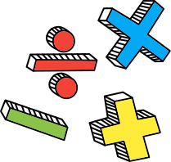
Logical Operations
Python supports logical operations such as and, or, and not. These are used to combine conditional statements and to derive a Boolean result.

Slide 15
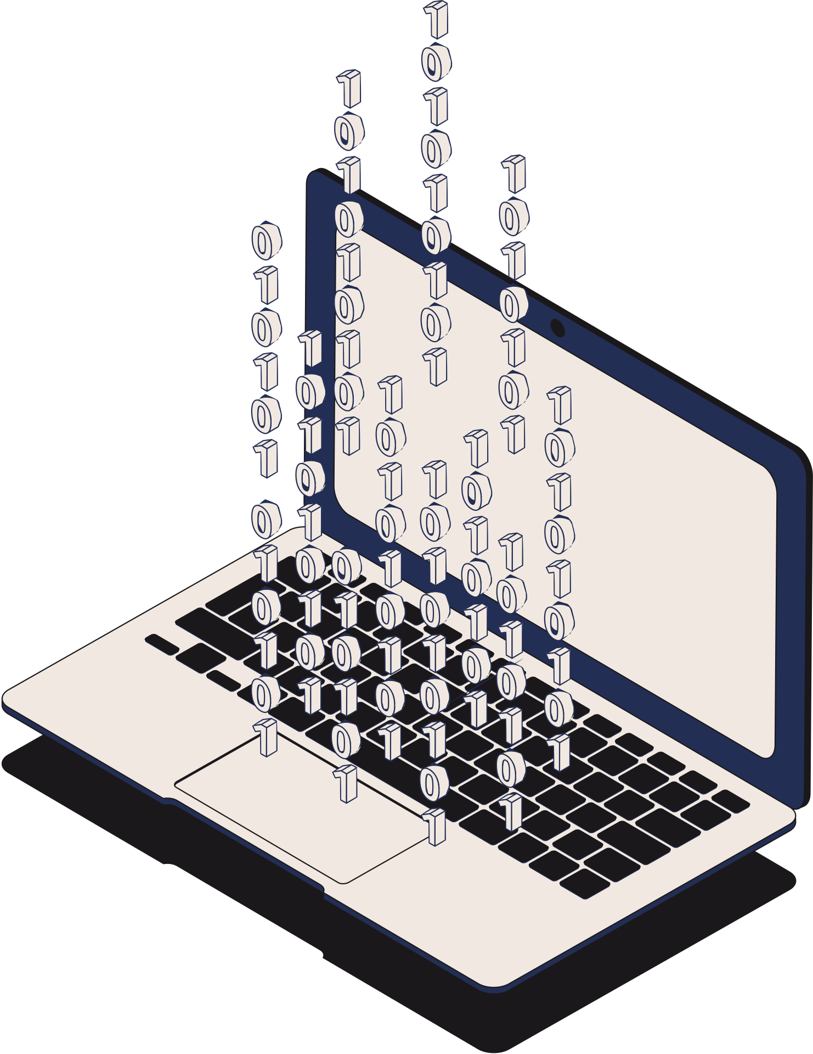
Bitwise Operations
Bitwise operations in Python include & (bitwise AND), | (bitwise OR), ^ (bitwise XOR), ~ (bitwise NOT), << (left shift), and >> (right shift). These operations directly manipulate bits of an integer's binary representation.

Slide 16
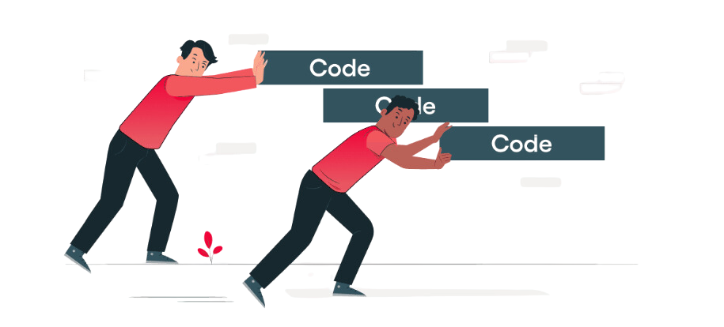
Indentation
Indentation is mandatory in python to define the blocks of statements.
It is preferred to use whitespaces instead of tabs to indent in python. Python uses four spaces as default indentation spaces.

Slide 17
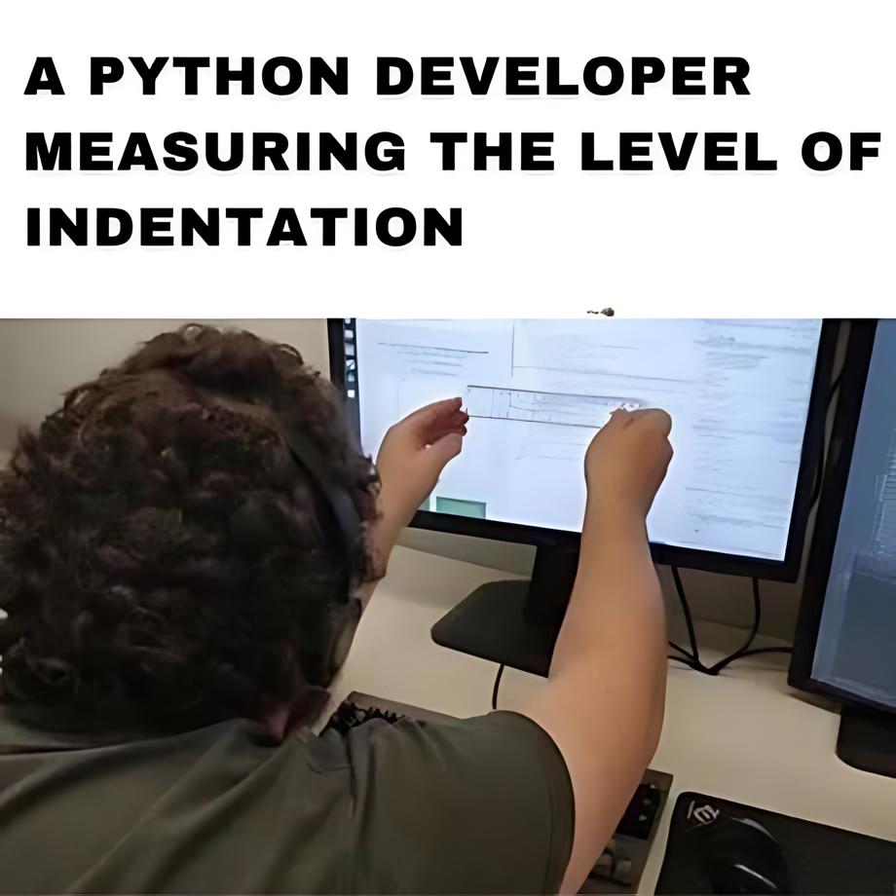
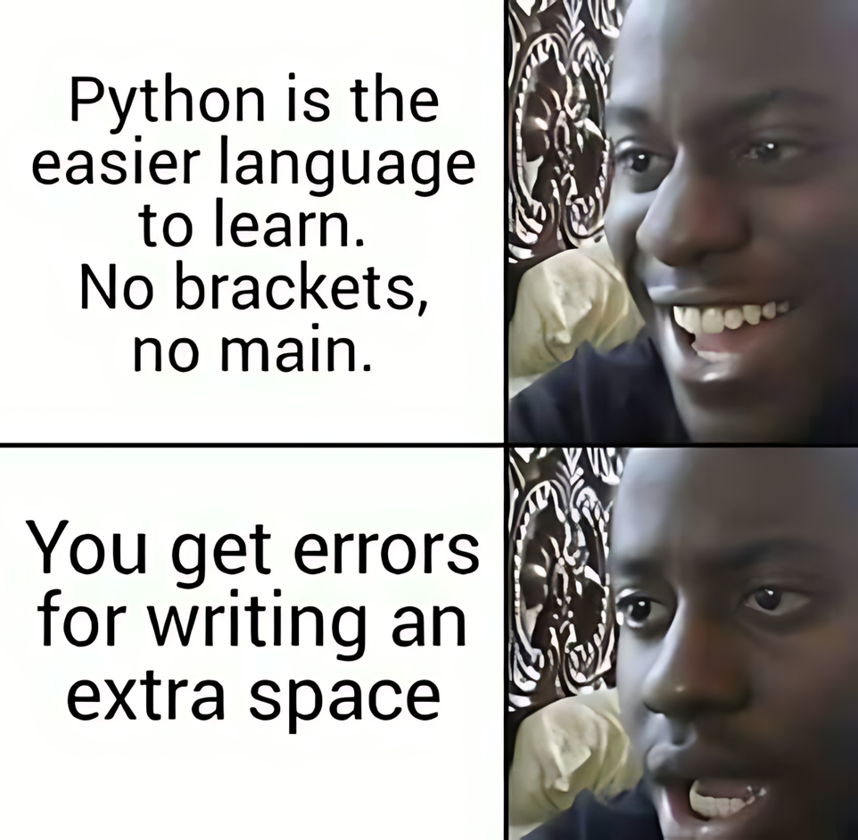

Slide 18
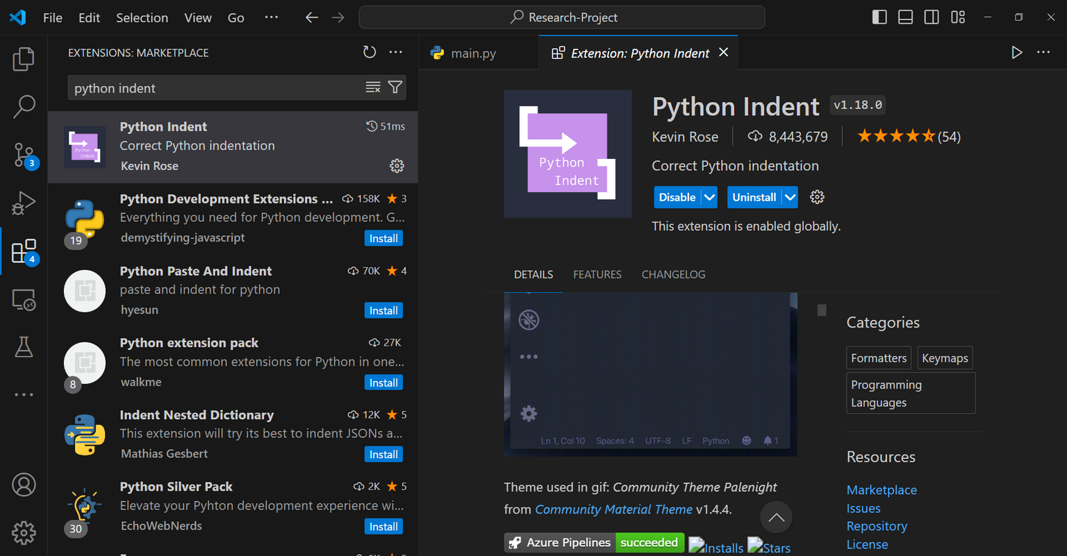
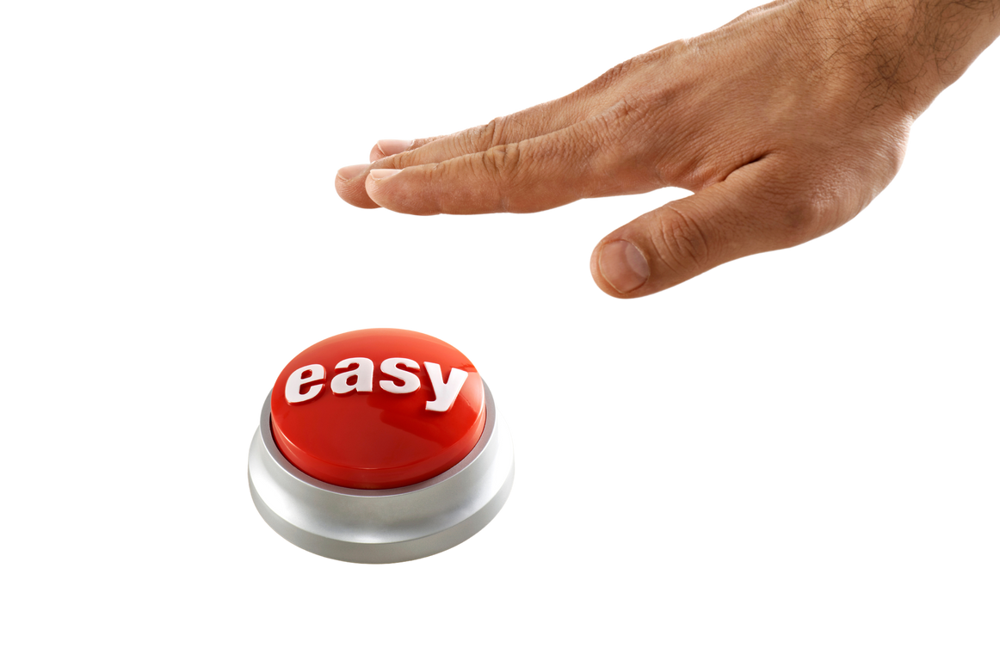
Make it easy!

Slide 19
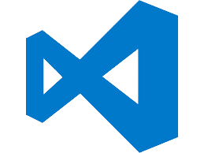
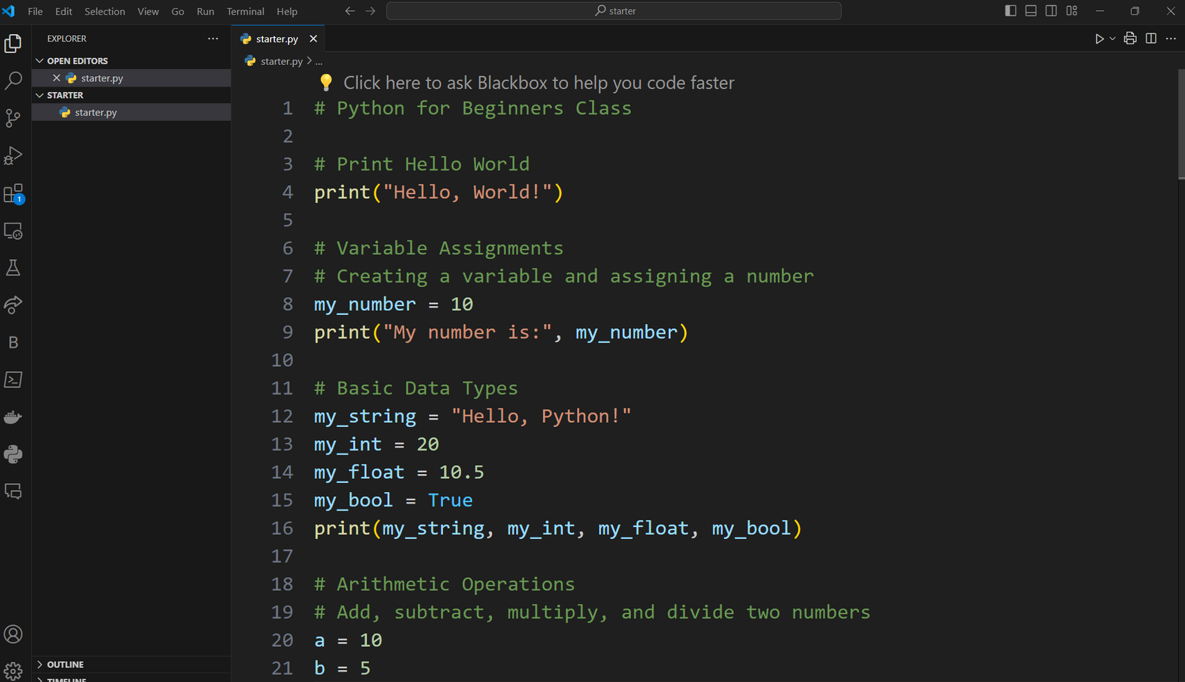
Basics of Python
Solution Code

Slide 20
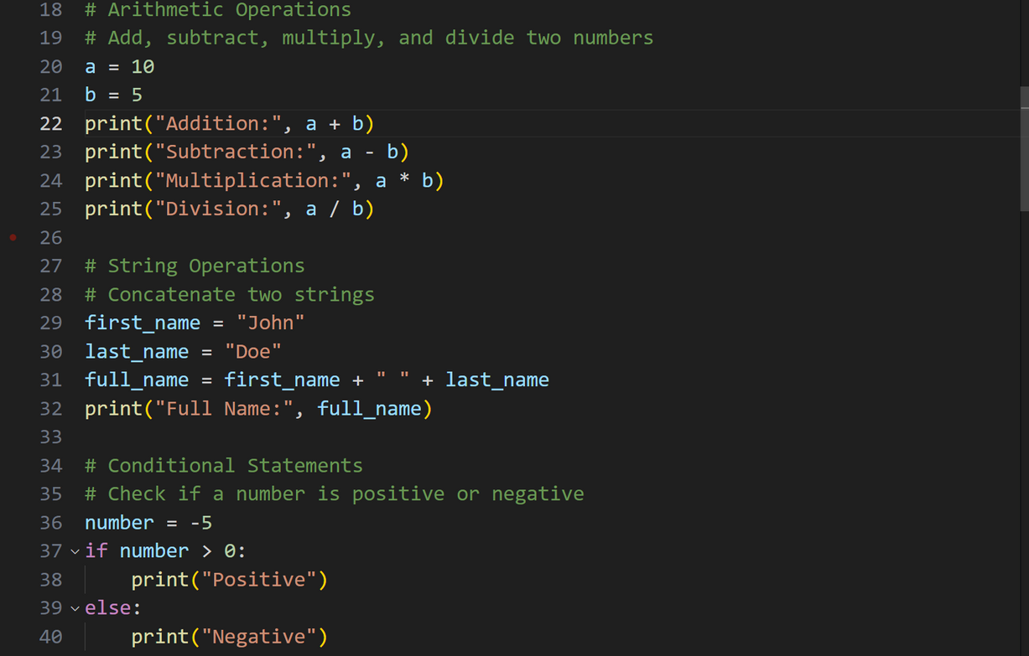
Basics of Python
Solution Code

Slide 21
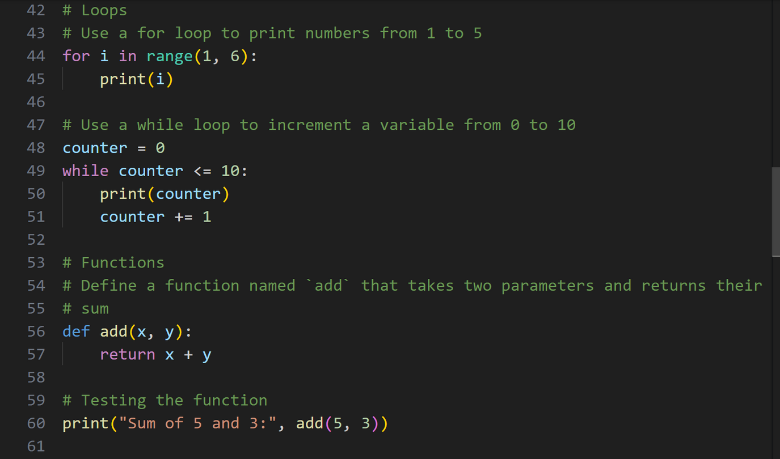
Basics of Python
Solution Code

Slide 22

What makes Python so special?
Python is an interpreted language.
If you want to program in Python, you'll need the Python interpreter. You won't be able to run your code without it. Fortunately, Python is free. This is one of its most important advantages.
Due to historical reasons, languages designed to be utilized in the interpretation manner are often called scripting languages, while the source programs encoded using them are called scripts.
Python is:
easy to learn,
easy to teach,
easy to use,
easy to understand,
easy to obtain

Slide 23
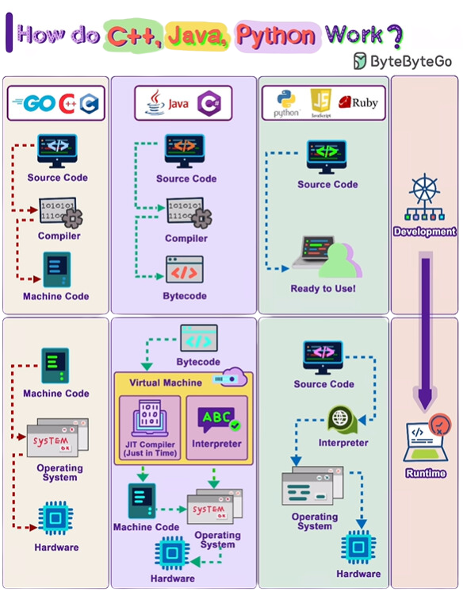

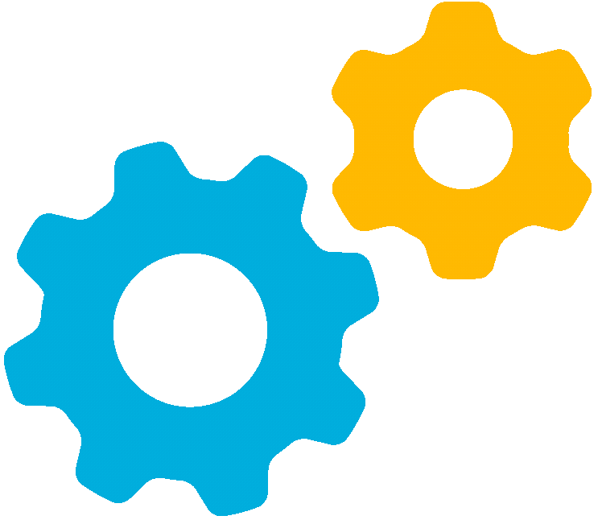
How compilation and Interpretations works

Slide 24
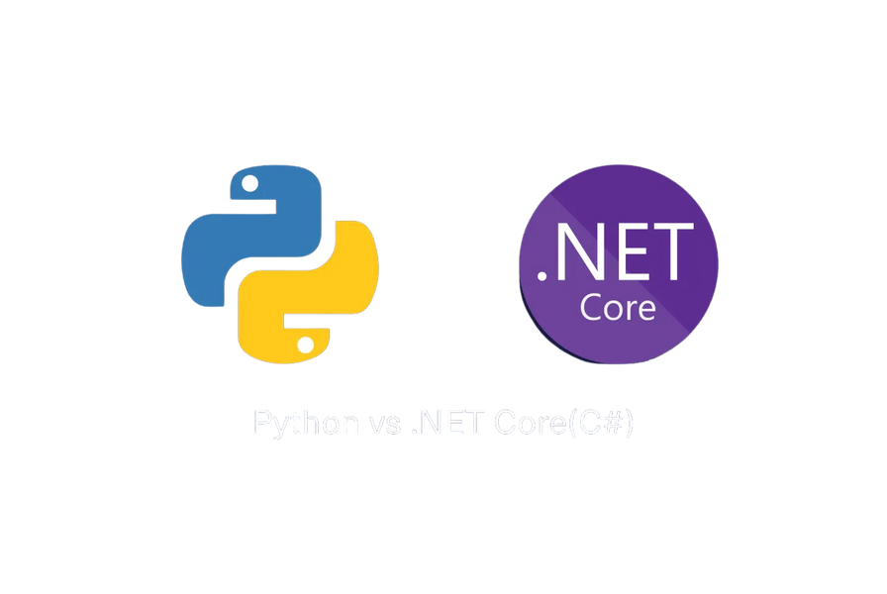

 | Python | C#
PROS | PROS | PROS
Readability | Highly readable syntax, easy for beginners. | Clear syntax influenced by C-style languages.
Flexibility | Dynamically typed, great for rapid prototyping. | Strongly typed, reducing runtime errors.
Libraries | Extensive standard library and third-party modules for various applications. | Comprehensive .NET library for desktop, web, and mobile apps.
Community | Large and active community, abundant resources and support. | Strong support from Microsoft, large enterprise use.
CONS | CONS | CONS
Performance | Generally slower due to being interpreted. | Requires .NET framework, which may not be available on all platforms.
Typing | Dynamic typing can lead to runtime errors. | Static typing can be verbose and rigid.
Application | May not be suitable for low-level programming due to abstraction. | Less popular in areas like data science and machine learning.

Slide 25
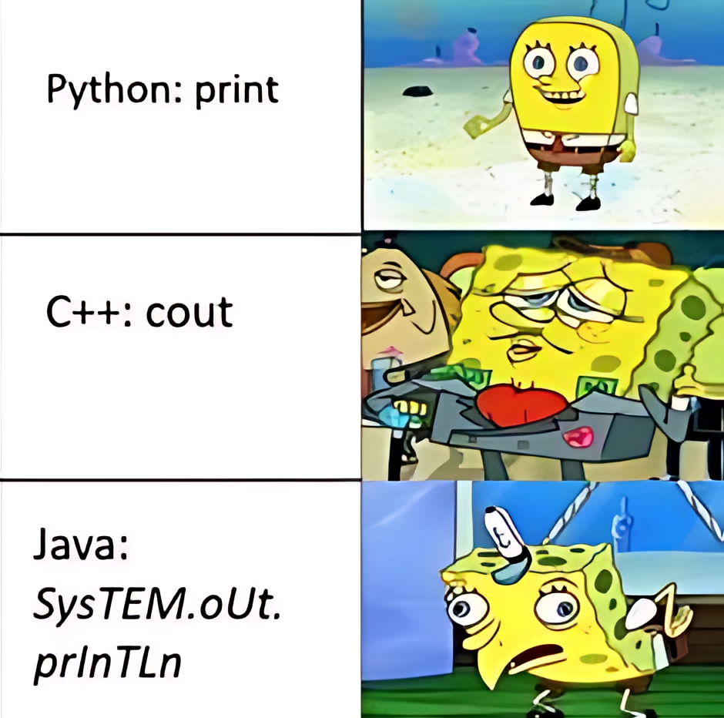

Slide 26
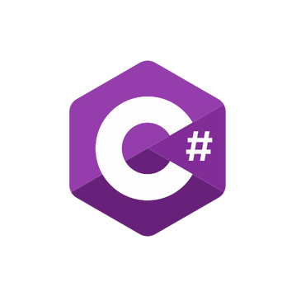
Excelled in simplicity, flexibility, and wide application in fields like web development, data science, and automation.
Known for its performance, robustness, and suitability for developing complex applications in .NET environments.

Slide 27
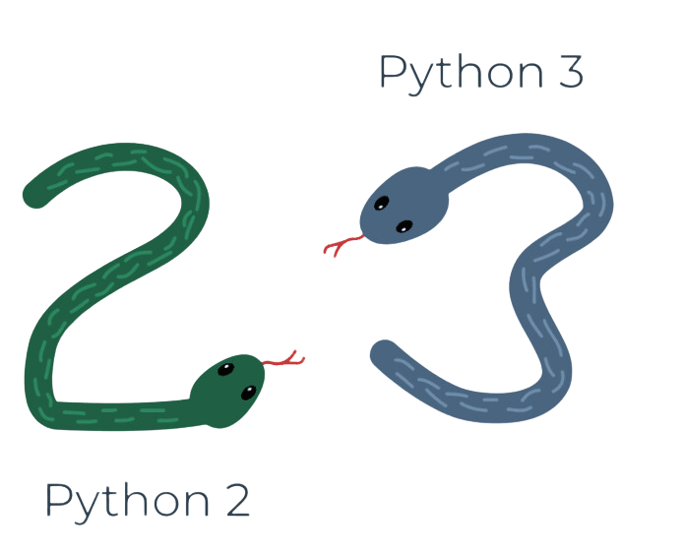
Python 2 vs. Python 3
These two versions of Python aren't compatible with each other. Python 2 scripts won't run in a Python 3 environment and vice versa.

Slide 28

Libraries and Frameworks
Rich and Versatile: Python's Standard Library includes a wide range of modules and functions, supporting tasks from file I/O, system calls, sockets, to data serialization, without the need for external libraries.
Batteries Included Philosophy: Python follows the "batteries included" philosophy, meaning its standard library comes with a rich set of modules and tools ready to handle various programming tasks, from text pattern matching to networking.
Python's Standard Library
Extensibility and Compatibility: The Standard Library is designed for easy extension and customization. Developers can leverage its well-documented APIs to build or enhance their applications with consistent and high-quality code.

Slide 29
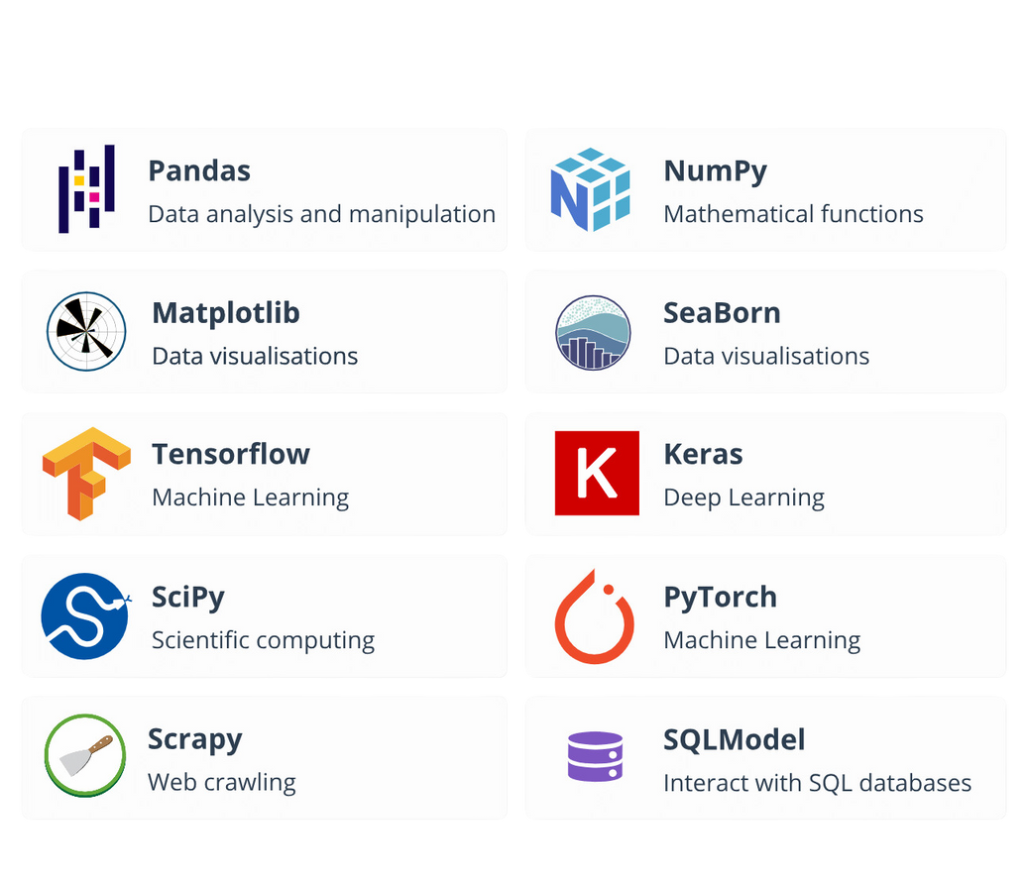
Understanding Python Libraries
What is a Python Library?
TOP 10
A reusable chunk of code that you can include in your programs to provide additional functionality without having to write it from scratch. Libraries in Python contain built-in modules and functions, which help in automating tasks, processing data, and more.
Python's extensive standard library, often referred to as its "batteries included" feature, along with these external libraries, makes it one of the most versatile and widely-used programming languages today.

Slide 30
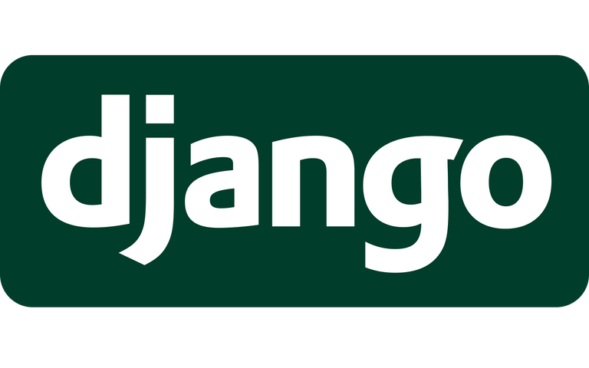



Leading Python Frameworks in Industry
A high-level framework that encourages rapid development and clean, pragmatic design.
A framework that is suitable for both small and large applications. It's known for its flexibility and scalability.
Django
Pyramid
Instagram, Pinterest, Mozilla. Django's robustness makes it ideal for high-traffic sites.
Dropbox, SurveyMonkey. Pyramid's adaptability makes it a good choice for projects that might grow in complexity.
A micro web framework known for its simplicity and fine-grained control. It's lightweight but extendable
A modern, fast (high-performance) web framework for building APIs with Python 3.6+ based on standard Python type hints.
Flask
FastAPI
Netflix, LinkedIn, Uber. Flask offers the flexibility needed for microservices and smaller applications.
Microsoft, Uber. FastAPI's speed and ease of use for creating RESTful APIs make it a great choice for companies with large-scale applications.

Slide 31
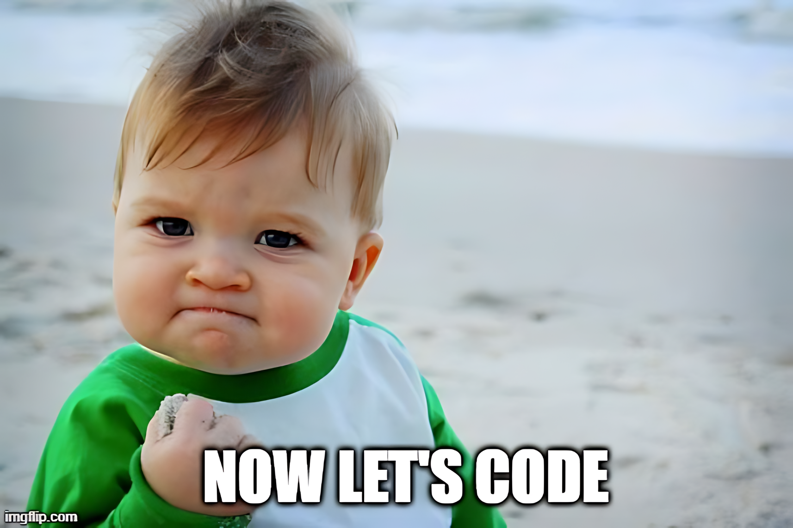

Slide 32
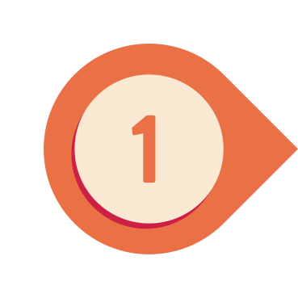
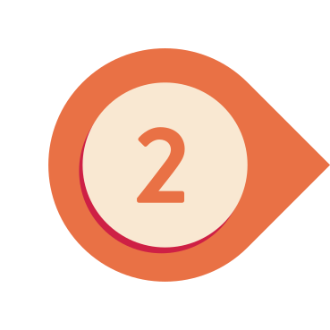
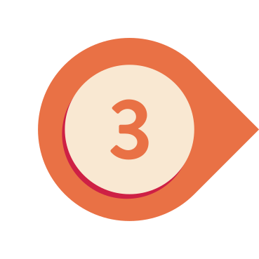
How to Get Started with Python
Visit the official Python website (python.org) and download the latest version of Python for your operating system.
Run the installer. Ensure to check the box that says "Add Python 3.x to PATH" to make Python accessible from the command line.
Complete the installation and verify it by opening your command line (CMD on Windows, Terminal on Mac/Linux) and typing python --version or python --V You should see the Python version number.

Slide 33
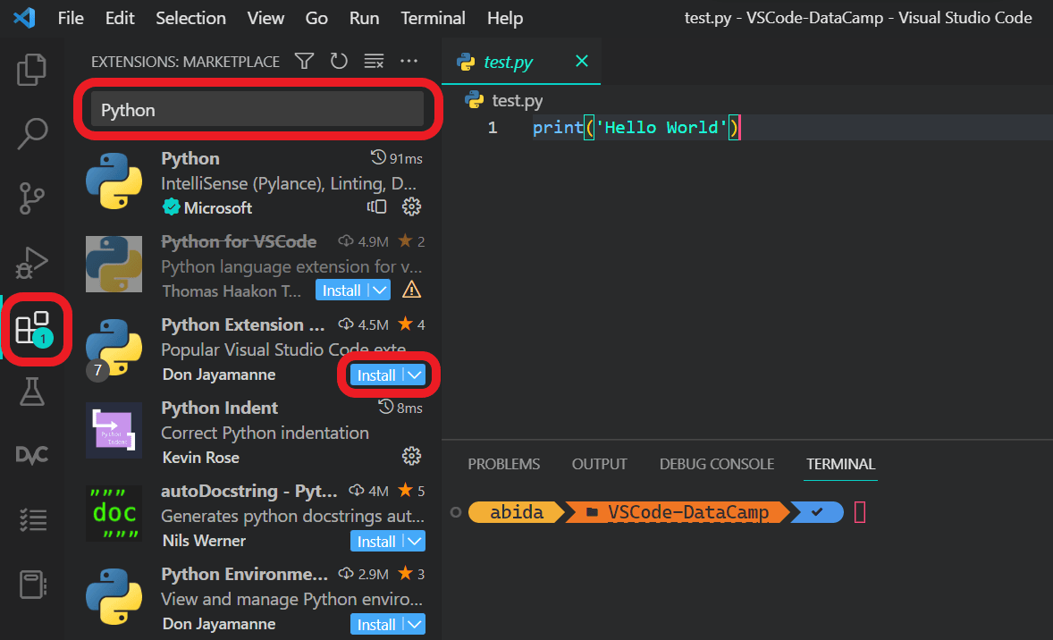
How to Get Started with Python

Slide 34
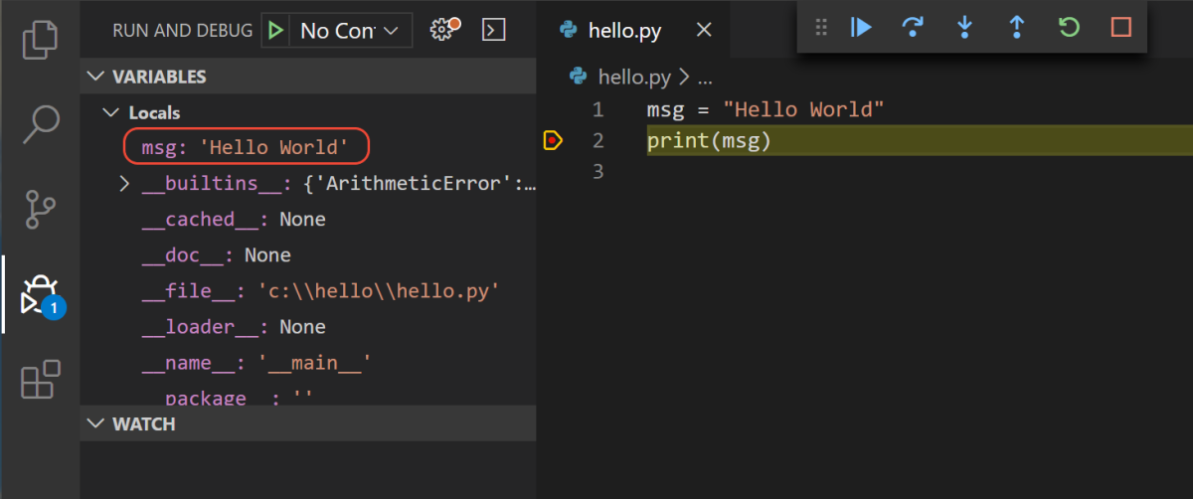
How to Get Started with Python

Slide 35
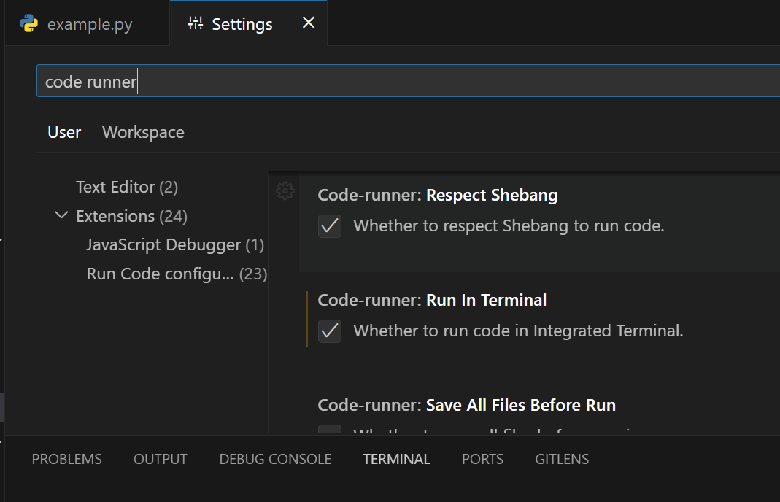

To use Input()

Slide 36

Finish it and win some candy
# Exercise 1: Variable Assignments and Operations
Instructions: Create two variables, assign numerical values, and perform all arithmetic operations
# Exercise 2: Simple Calculator with Conditional Statements
Instructions: Ask the user for two numbers and an operation; perform the operation
# Exercise 3: Loop through a List
Instructions: Create a list of numbers and use a loop to print each element
# Exercise 4: Function that returns the sum of two numbers
Instructions: Write and test a function that returns the sum of two numbers

Slide 37

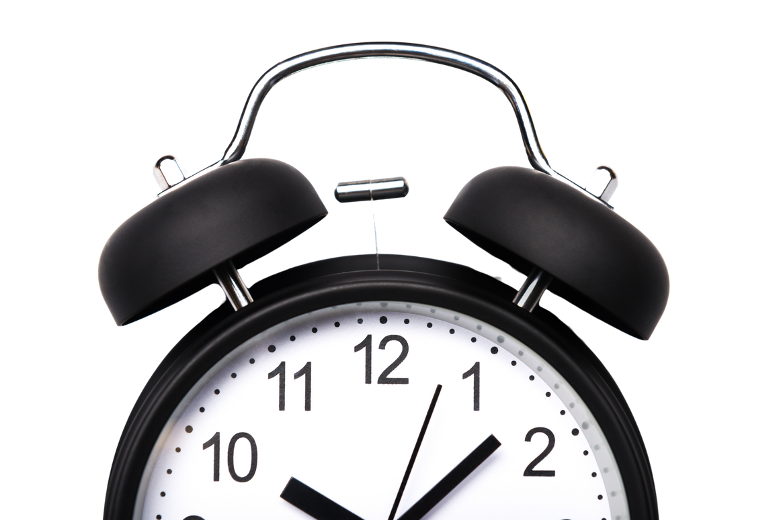

Slide 38
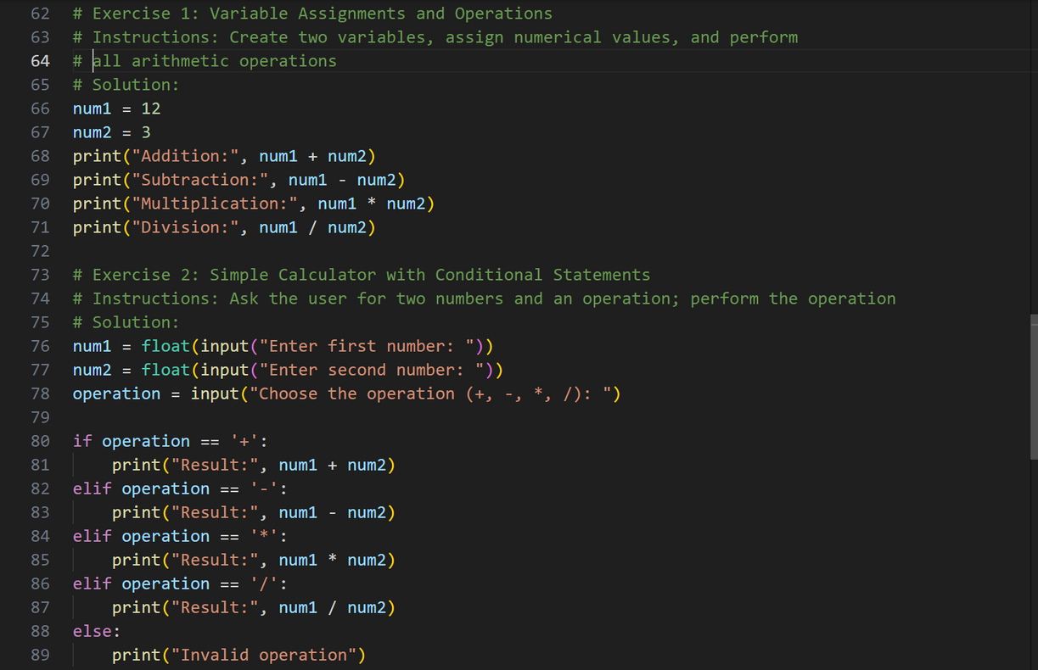
Basics of Python
Solution Code

Slide 39
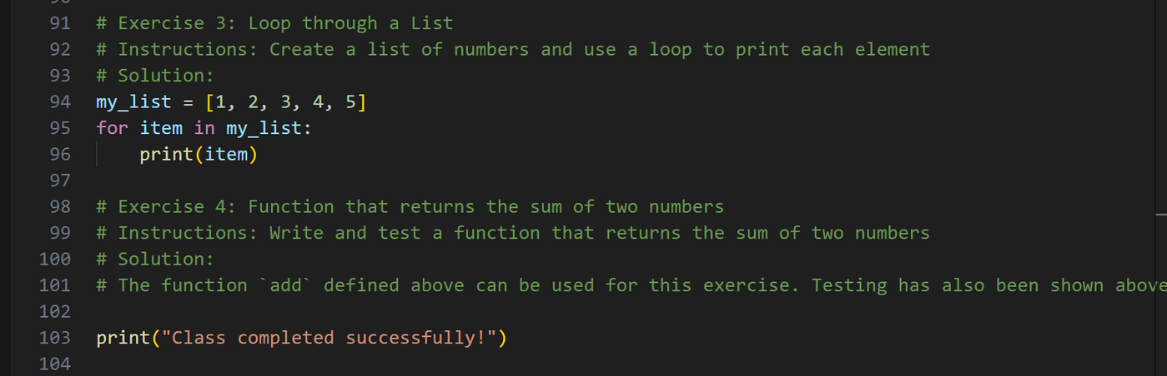
Basics of Python
Solution Code

Slide 40
Thank you!
ANY QUESTION?

